Slide 1
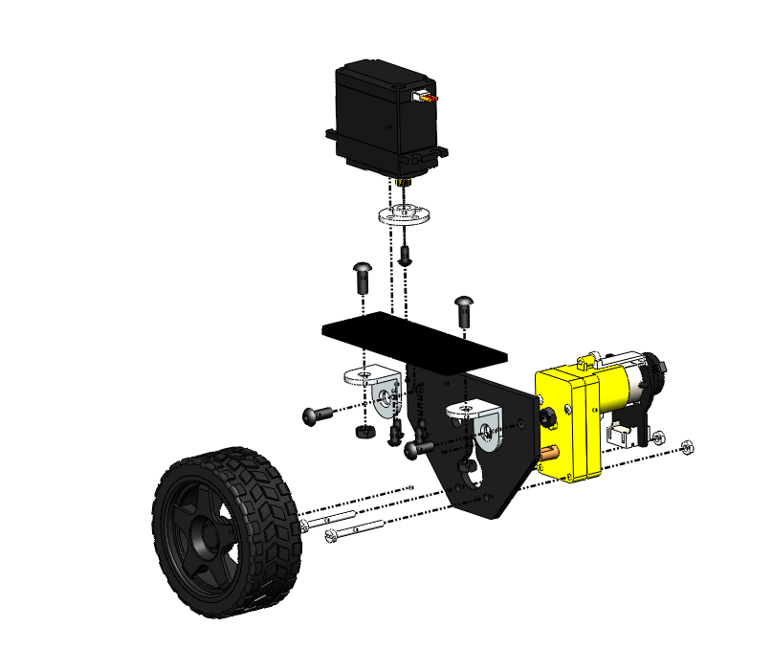
4
1
5
3
2

Slide 2
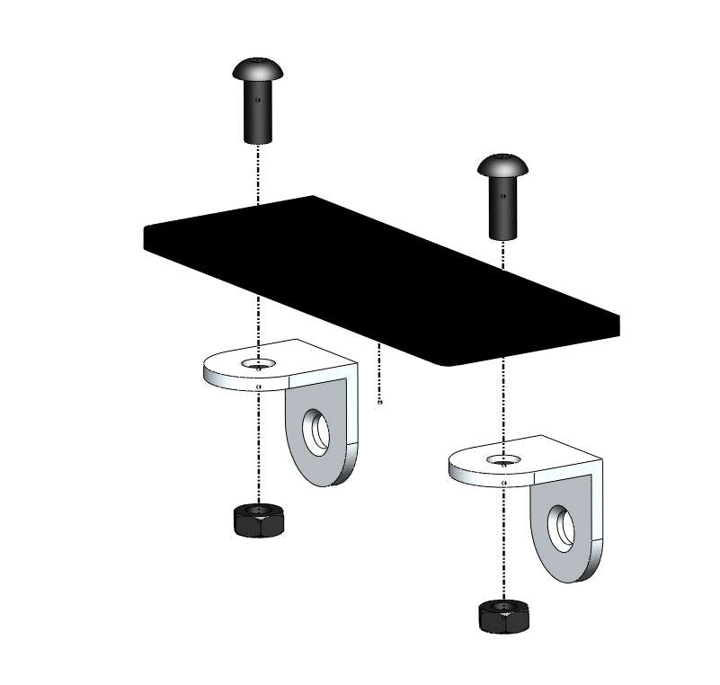
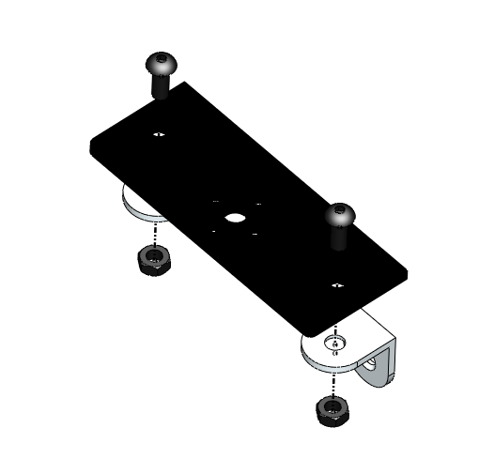
TOP VIEW
M4 x 10 BOLT
M4 NUT

Slide 3
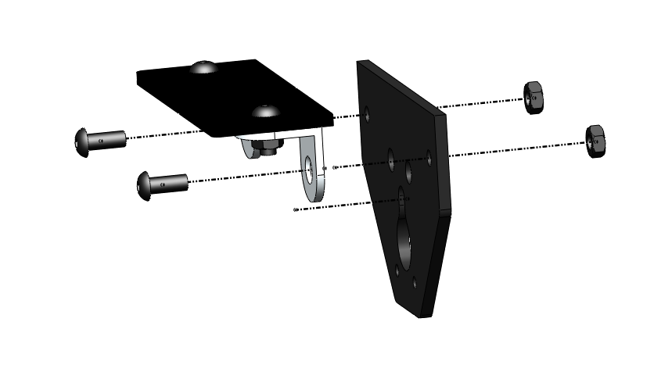
M4 x 10 BOLT
M4 NUT

Slide 4
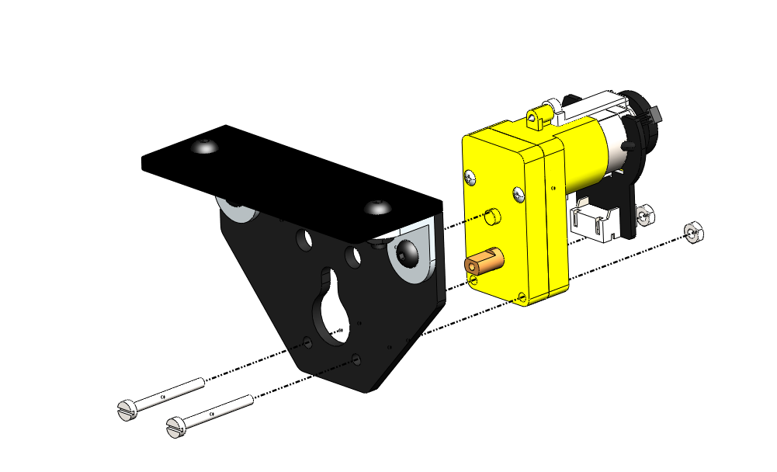
M2.5 x 25 BOLT
M2.5 NUT

Slide 5
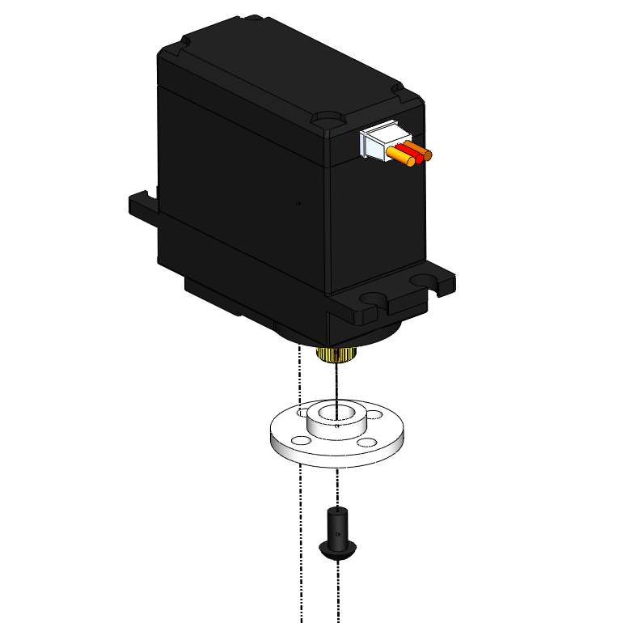
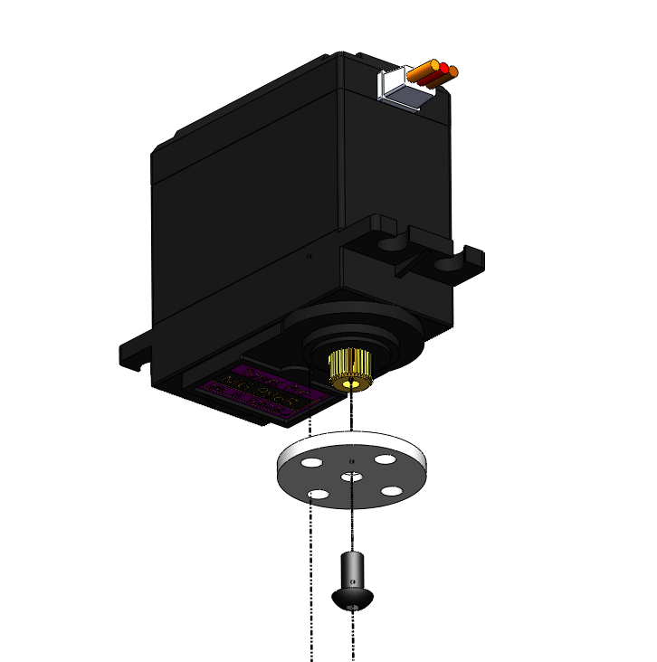
M3 x 6 BOLT
BOTTOM VIEW

Slide 6
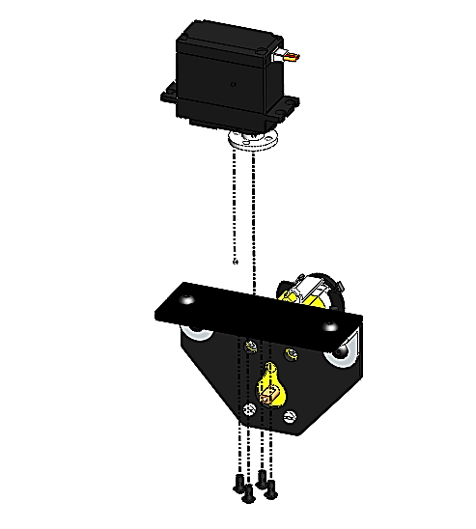
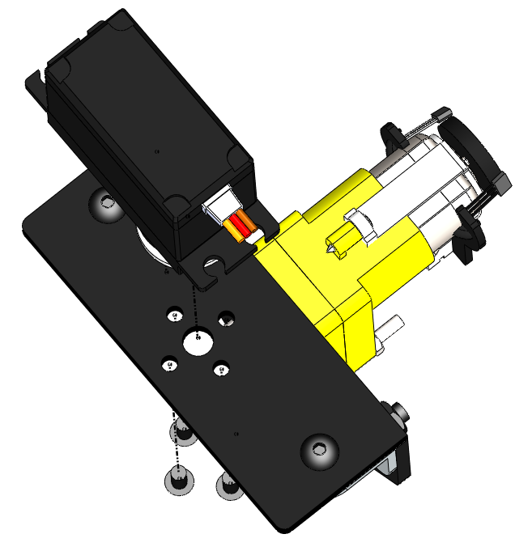
TOP VIEW
M3 x 6 BOLT

Slide 7
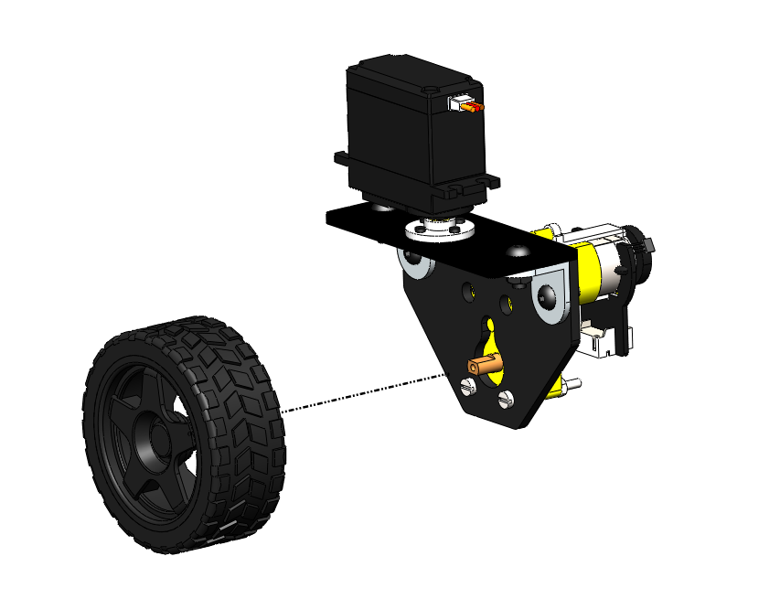
WHEEL PRESS FIT INTO THE MOTOR SHAFT

Slide 8
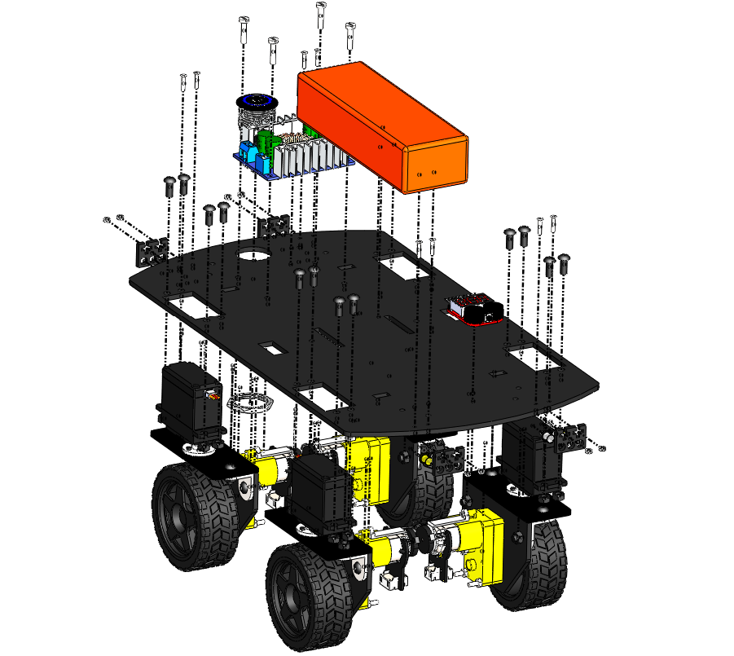
2
4
3
6
5
7
1

Slide 9
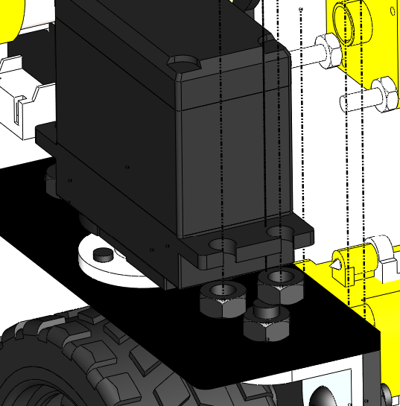
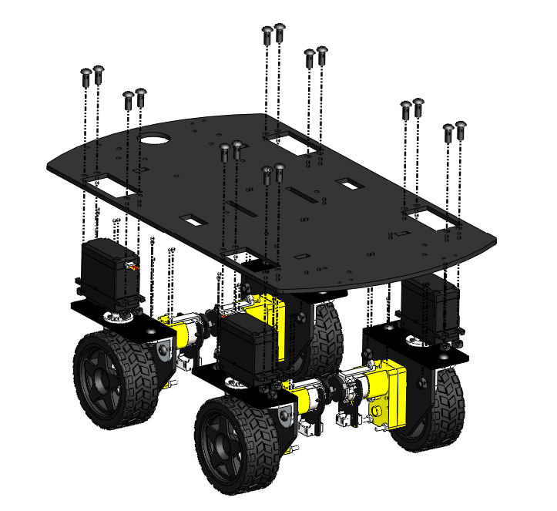
M4 X 10 BOLT
M4 NUT
THIS FACE IS PLACED FLUSH AGAINST THE PLATFORM

Slide 10
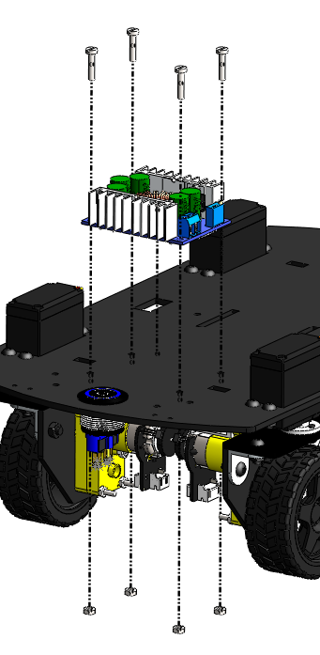
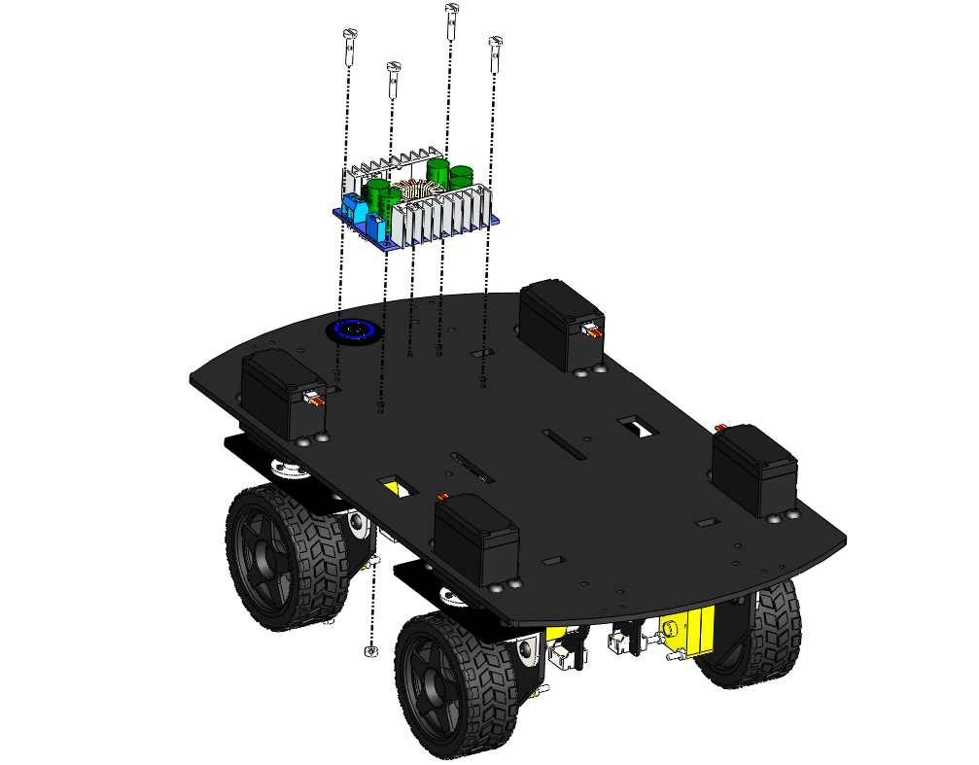
M3 X 14 BOLT
REAR VIEW
M3 NUT

Slide 11
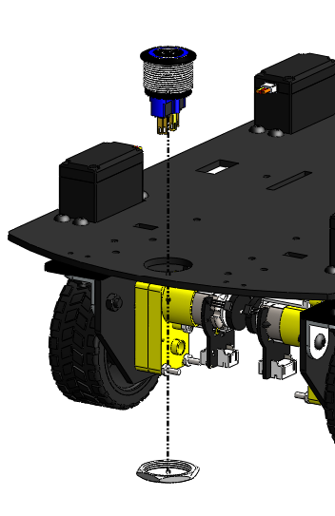
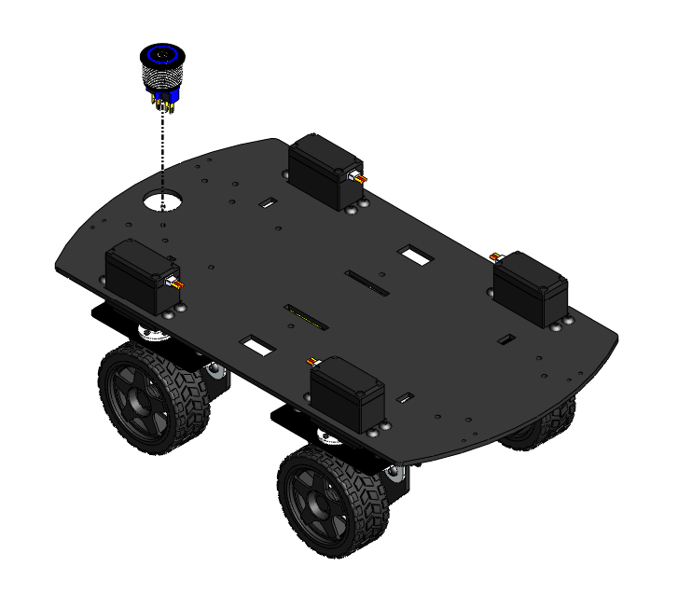
REAR VIEW
THE SWITCH IS INSERTED INTO THE SLOT FROM ABOVE, THEN THE NUT IS TWISTED IN PLACE FROM BELOW

Slide 12
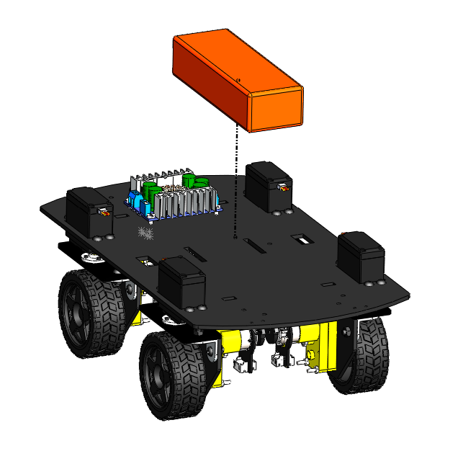
BATTERY STRAP SLOTS
BATTERY STRAP SLOTS

Slide 13
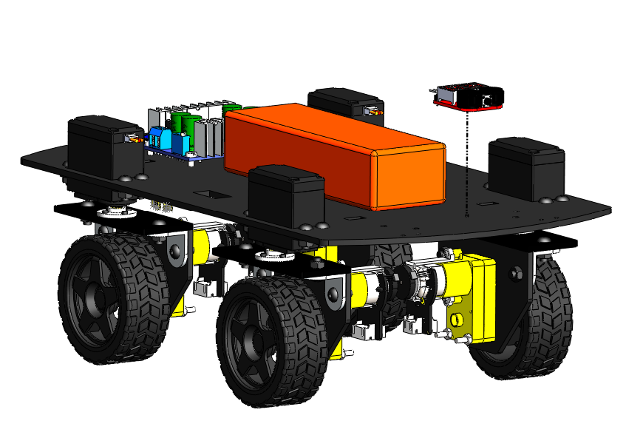
DOUBLE SIDED TAPE

Slide 14
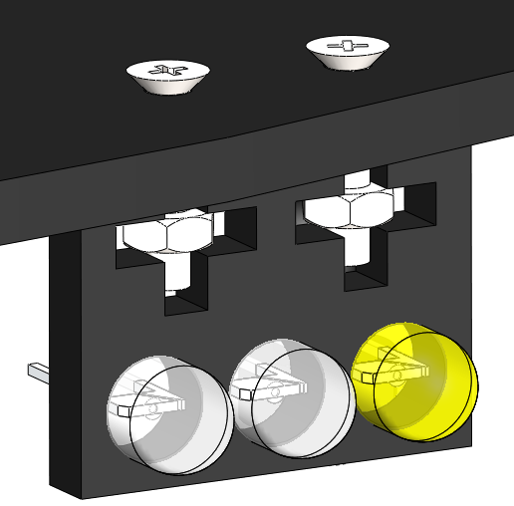
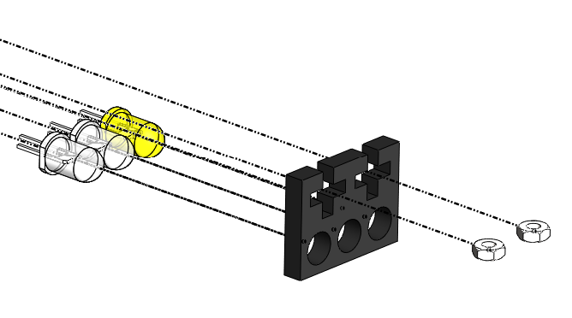
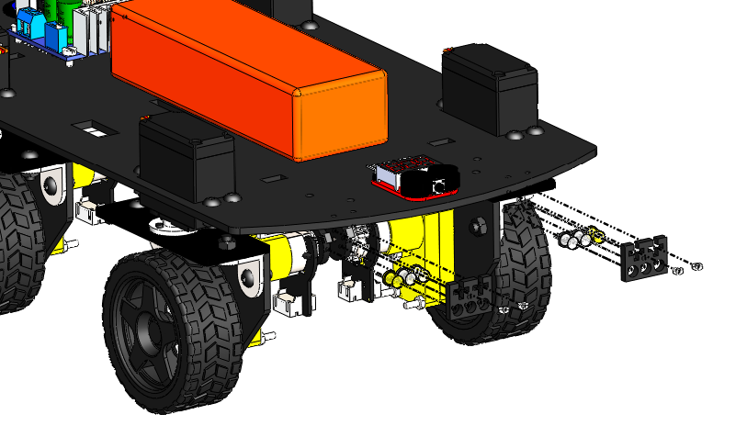
M2 NUT

Slide 15
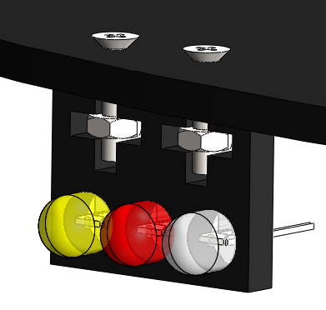
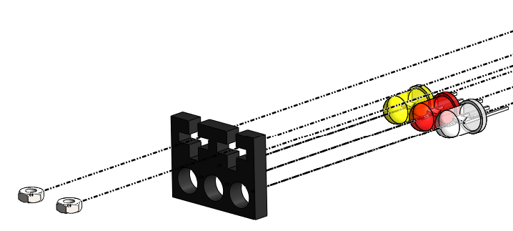
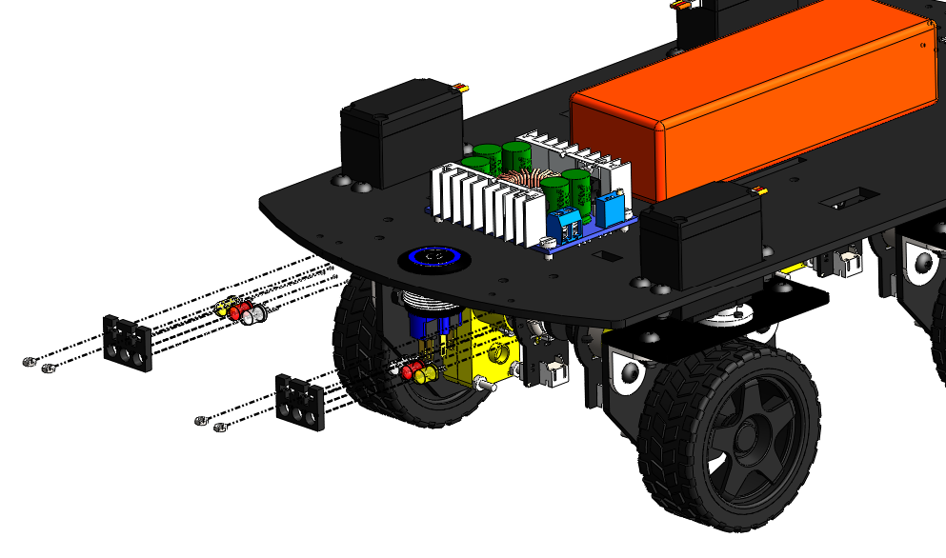
M2 NUT

Slide 16
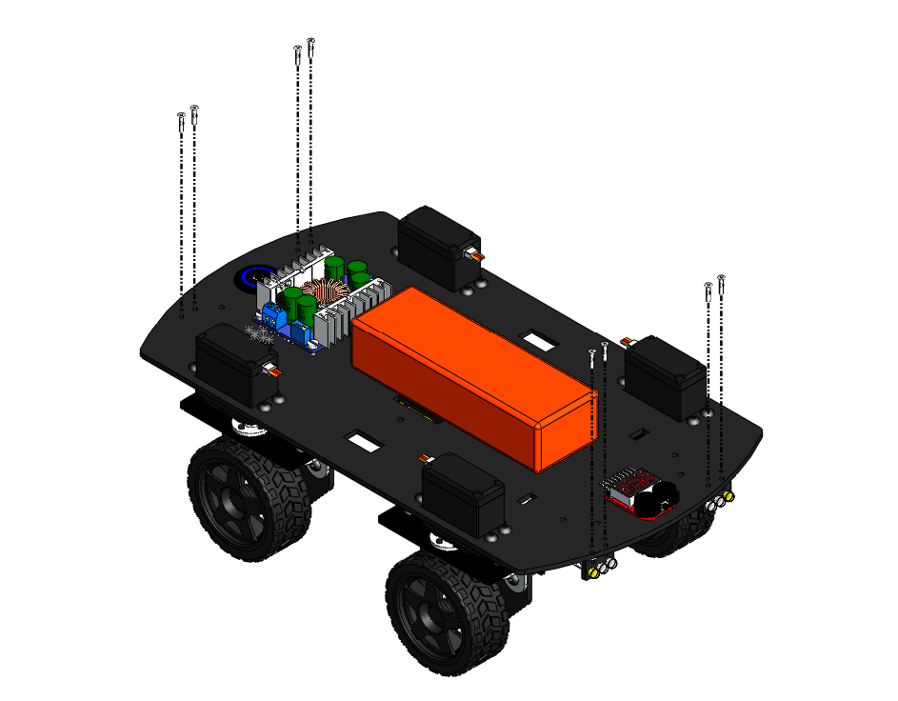
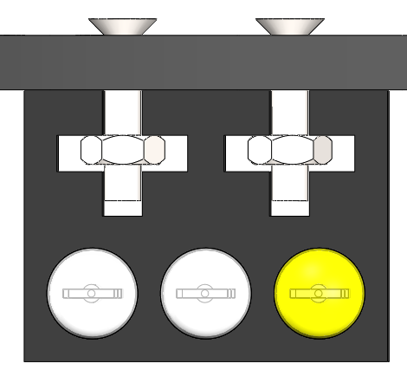
M2 X 10 BOLT

Slide 17
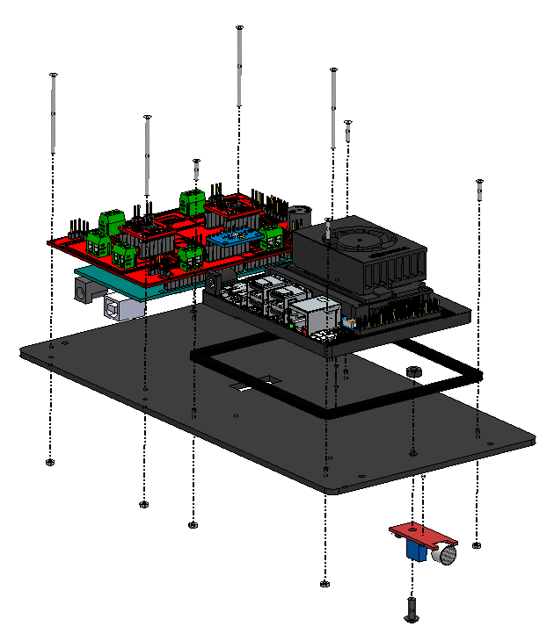
2
1
3

Slide 18
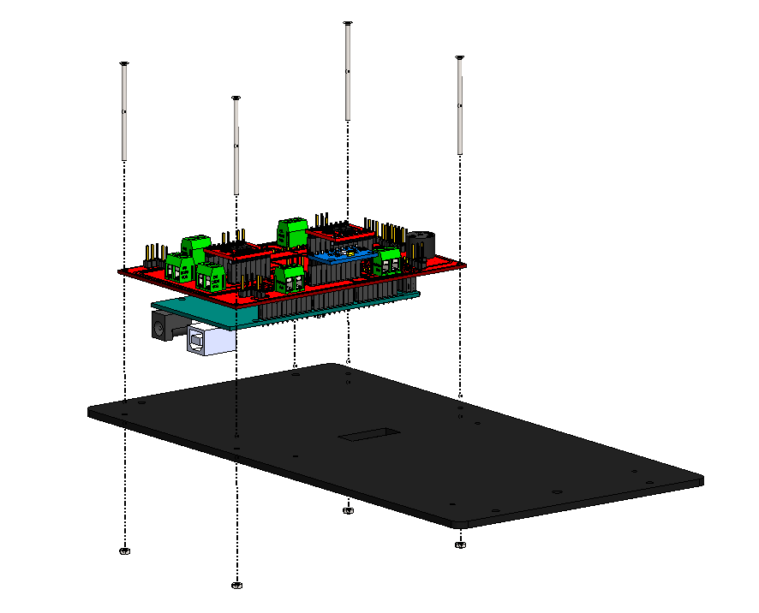
M2 x 25 BOLT
M2 NUT

Slide 19
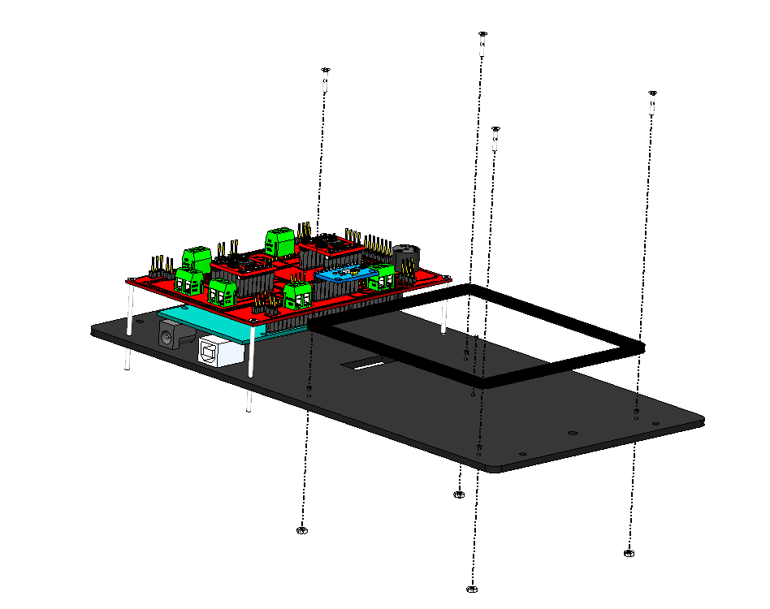
M2 x 10 BOLT
M2 NUT

Slide 20
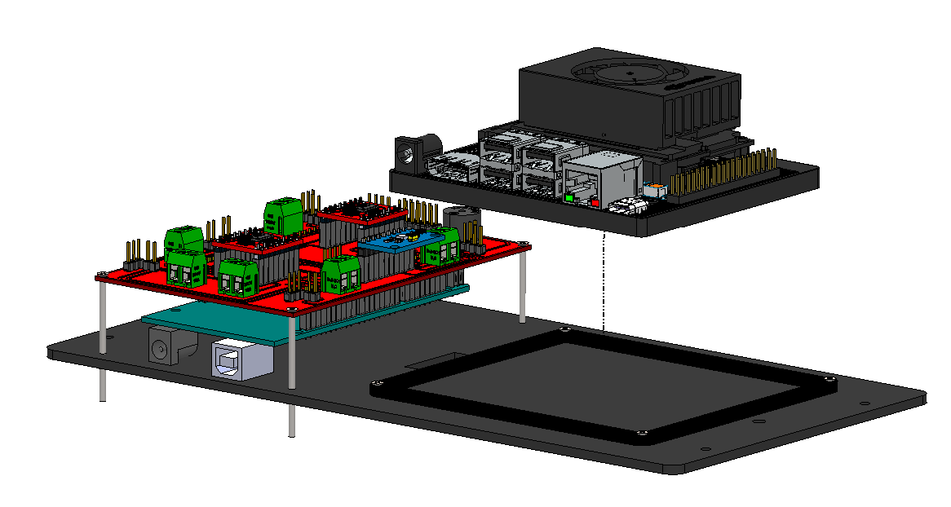

Slide 21
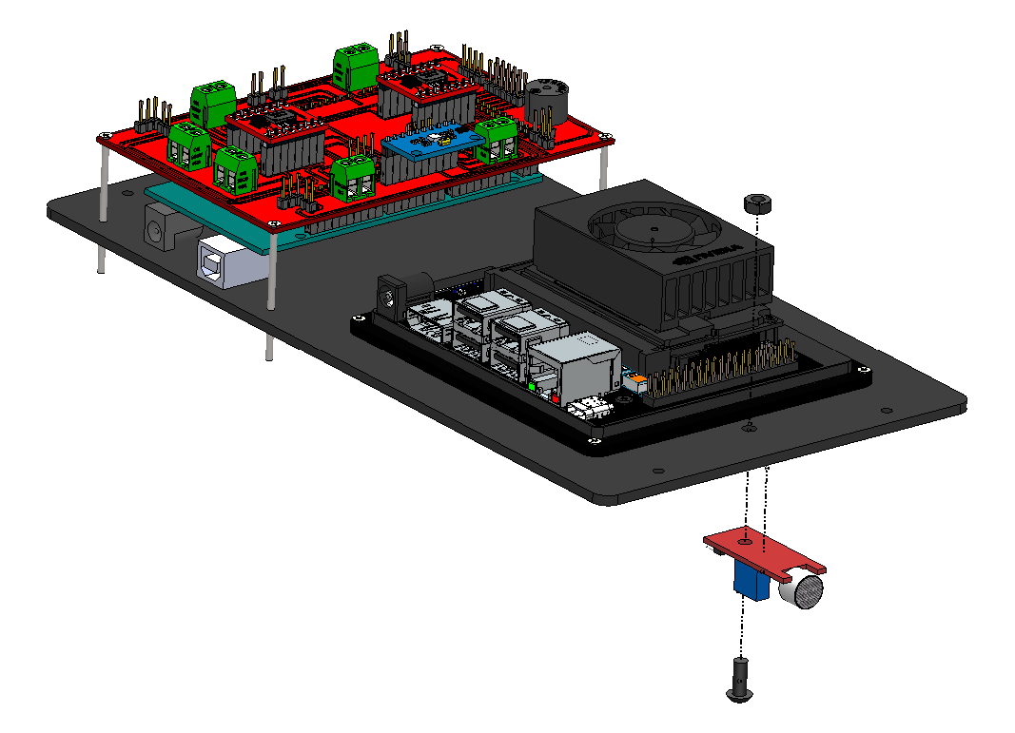
M4 NUT
M4 x 10 BOLT

Slide 22
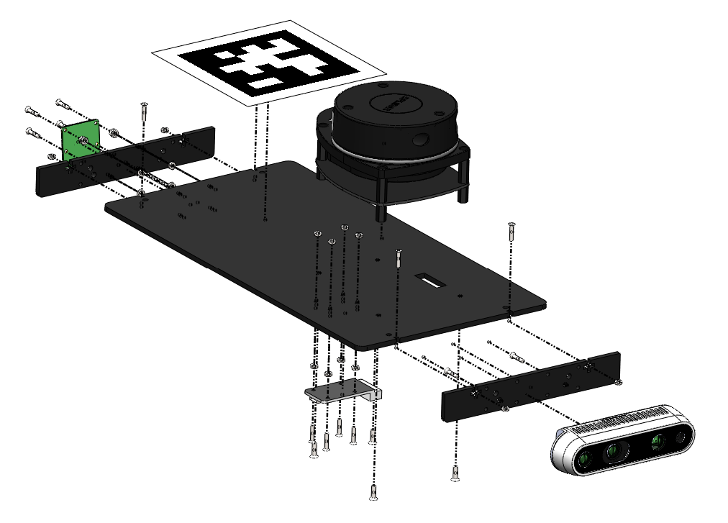
5
2
4
3
1

Slide 23
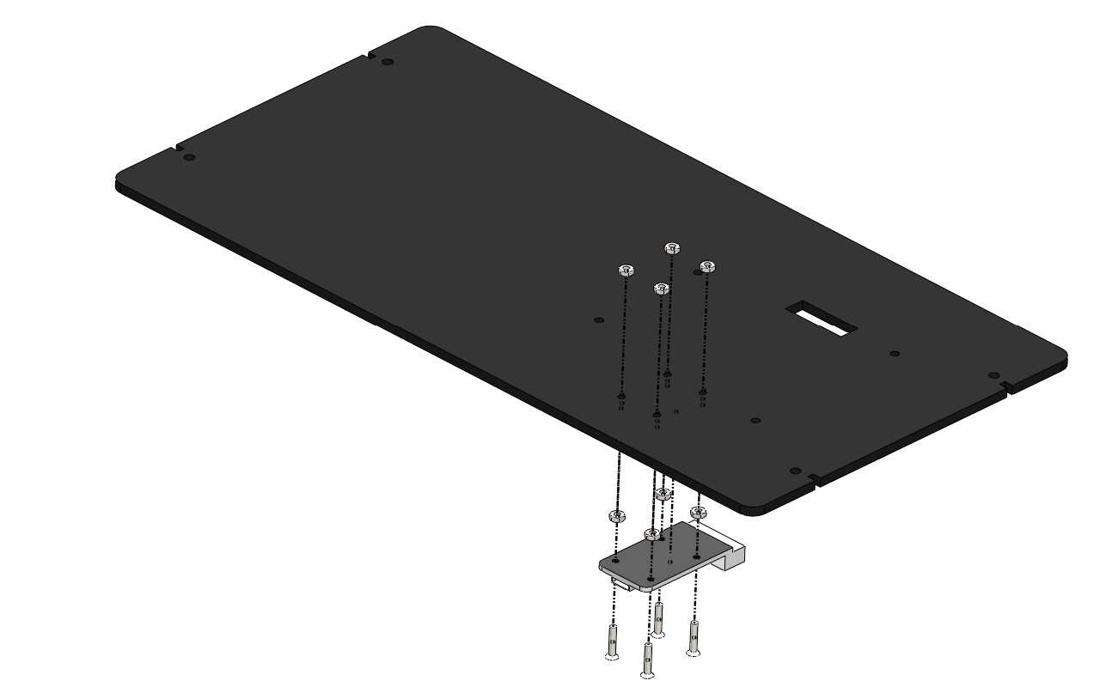
M2 NUT
M2 NUT AS A SPACER
M2 x 10 BOLT

Slide 24
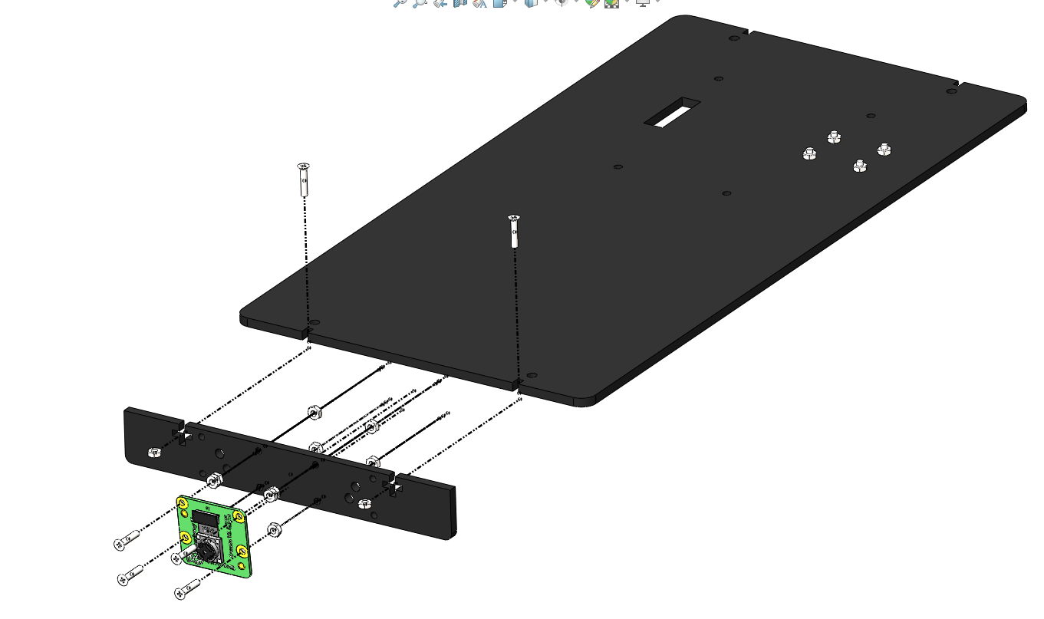
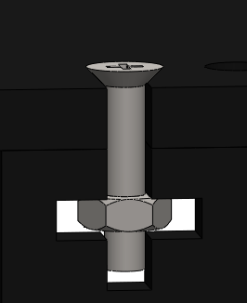
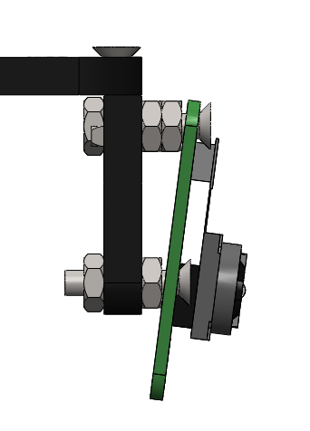
M2 x 10 BOLT
2 NUTS ON TOP
M2 NUT
M2 NUT
M2 x 10 BOLT
SIDE VIEW

Slide 25
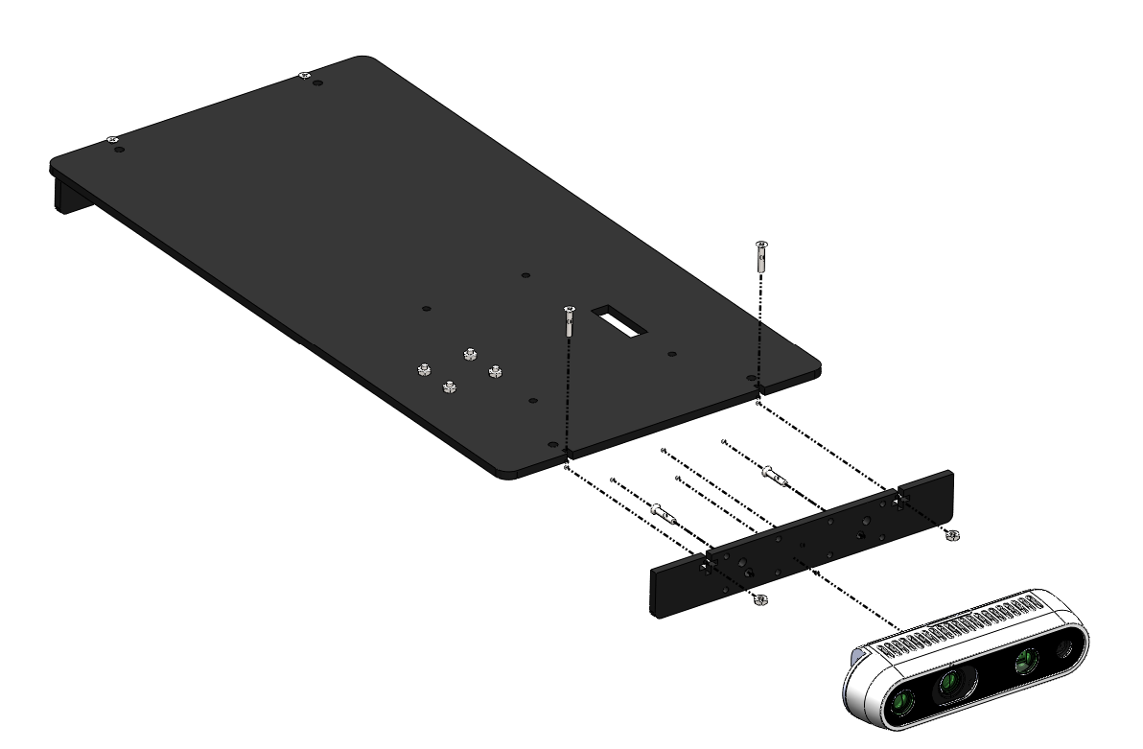
M3 x 8 BOLT
M3 x 6 BOLT
M2 NUT

Slide 26
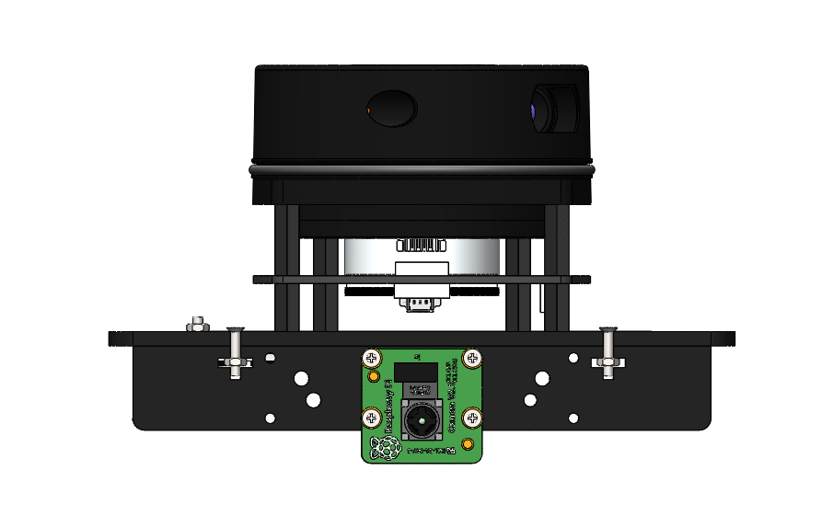
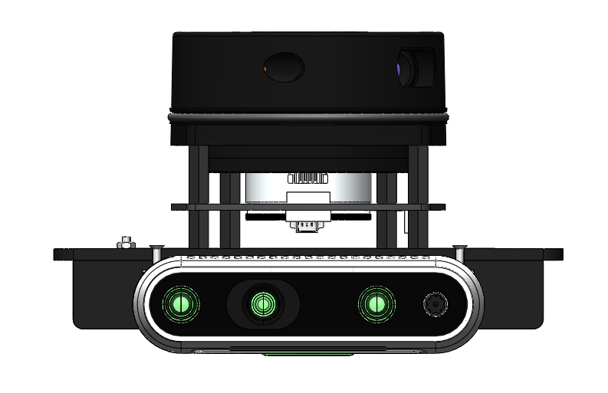
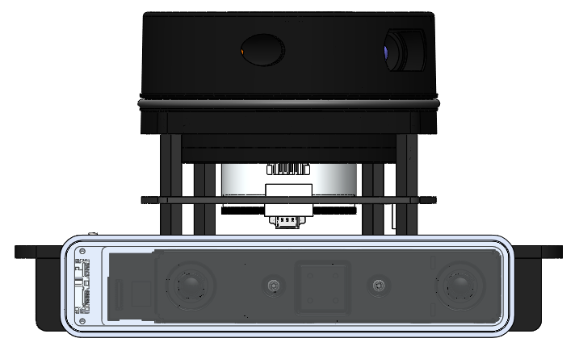

Slide 27

PI CAM v2.1 | INTEL D435i | INTEL T265

Slide 28
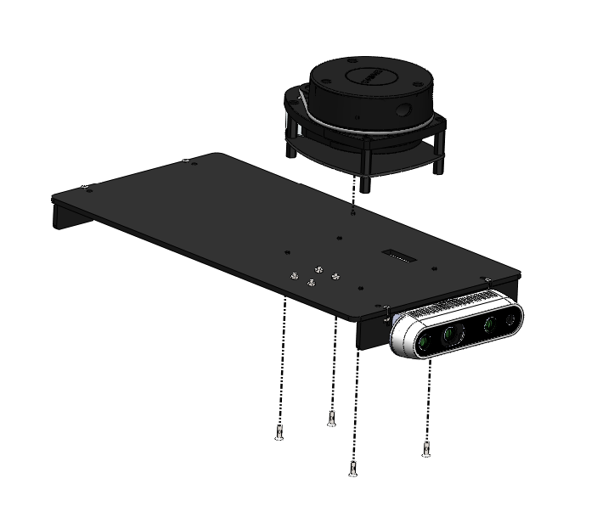
M2.5 x 8 BOLT

Slide 29
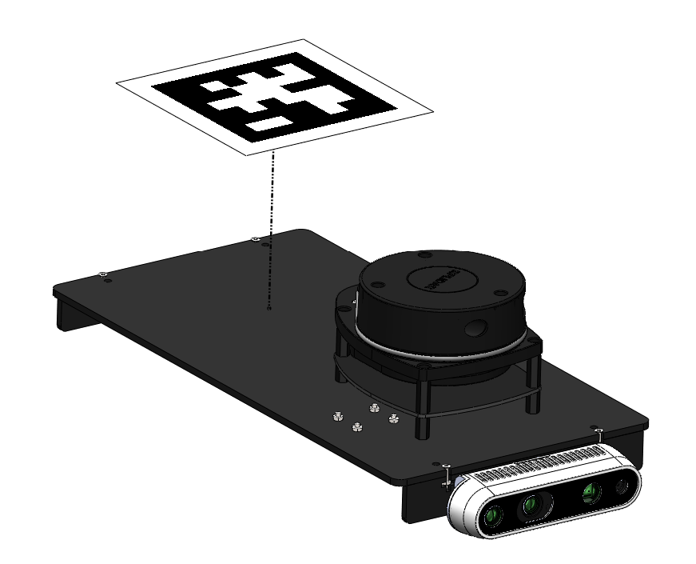
APRIL TAG IS PASTED ON

Slide 30
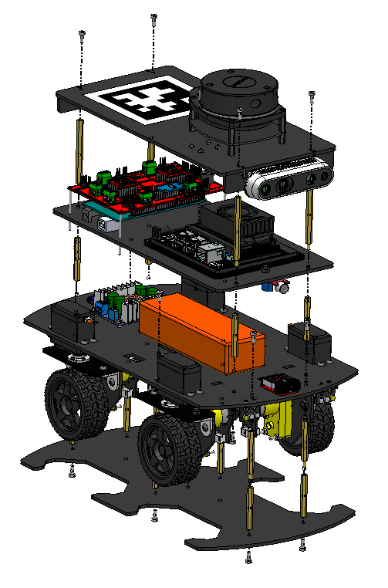
6
4
5
3
1
2

Slide 31
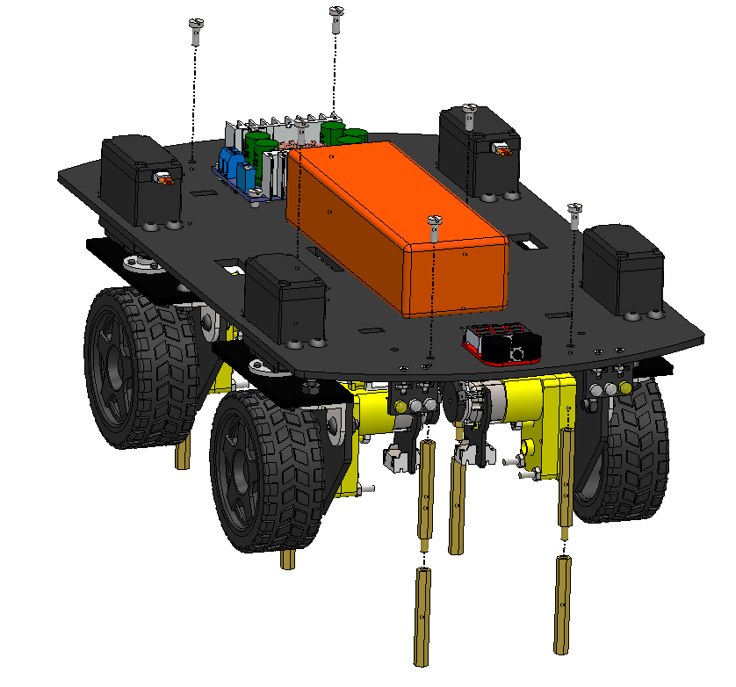
M3 X 8 BOLT
M3 x 40 M-F STANDOFF
MALE SIDE
M3 x 40 F-F STANDOFF

Slide 32
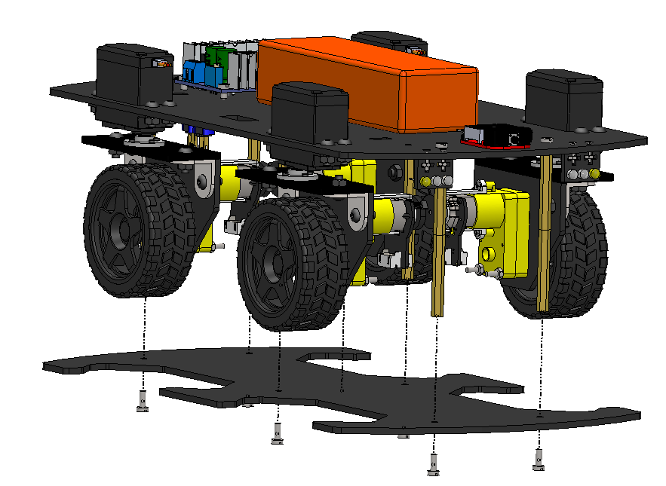
M3 x 40 M-F STANDOFF
+
M3 x 40 F-F STANDOFF
STACK
M3 X 8 BOLT

Slide 33
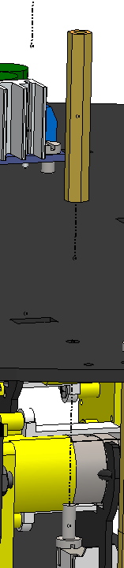
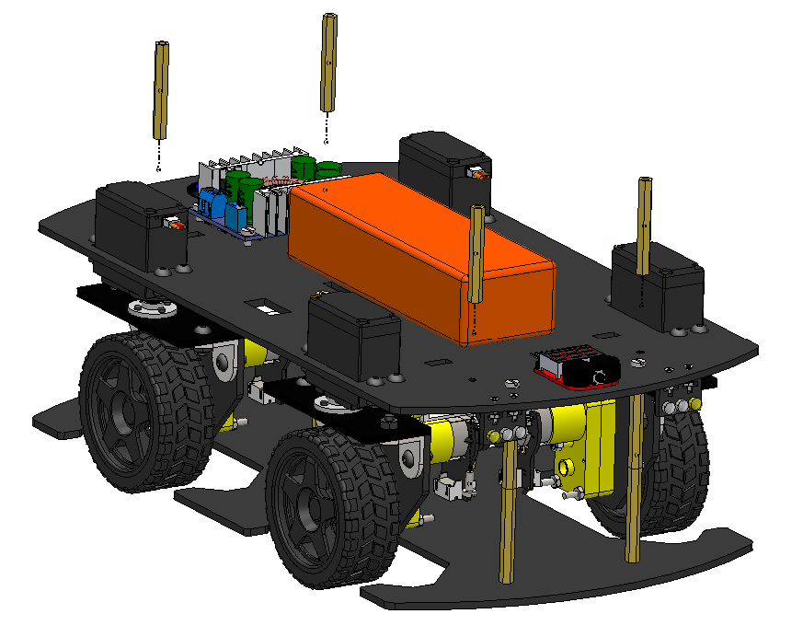
M3 x 40 F-F STANDOFF
M3 X 8 BOLT

Slide 34
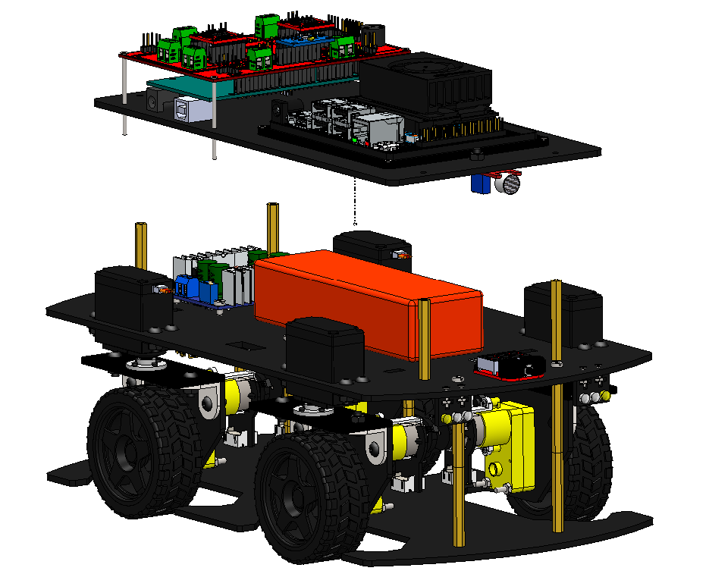

Slide 35
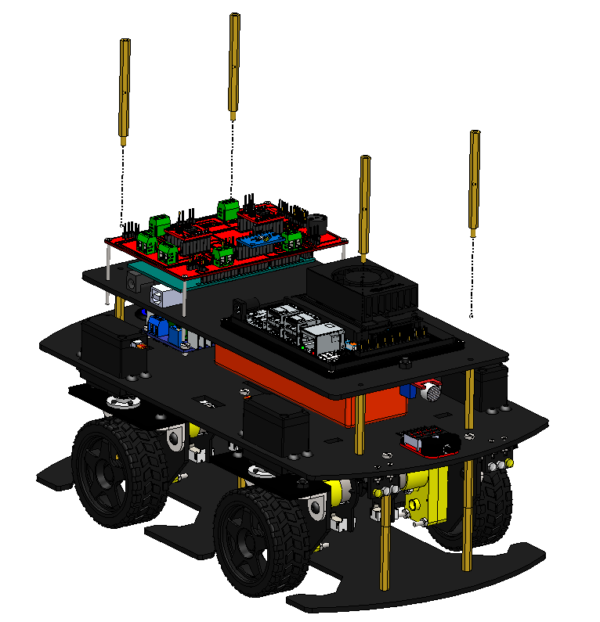
M3 x 60 M-F STANDOFF
FEMALE SIDE
MALE SIDE

Slide 36

M3 X 8 BOLT

